Slide 1
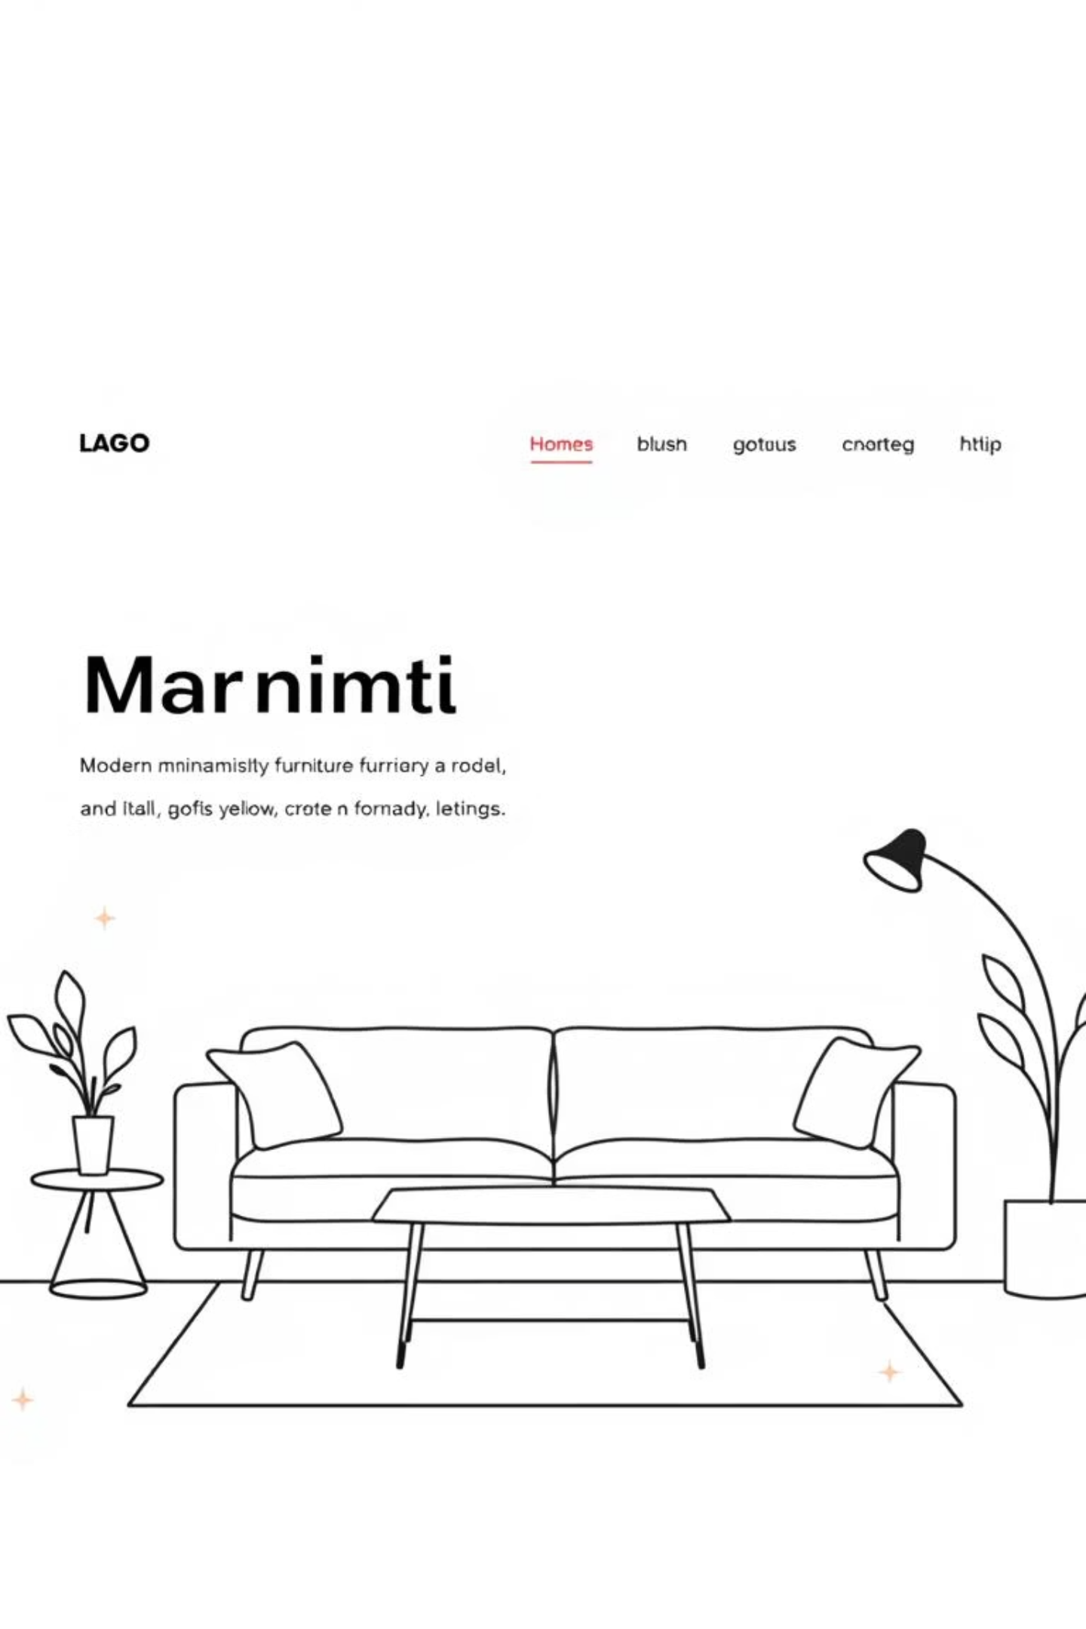

Furniture Sales Website
Web Application Development
Final Project
Student name(s): Nguyen Huu Khanh– ITCSIU21076
Nguyen Thanh Khiem– ITCSIU21137
Advisor: Dr. Nguyen Trung Nghia

Slide 2
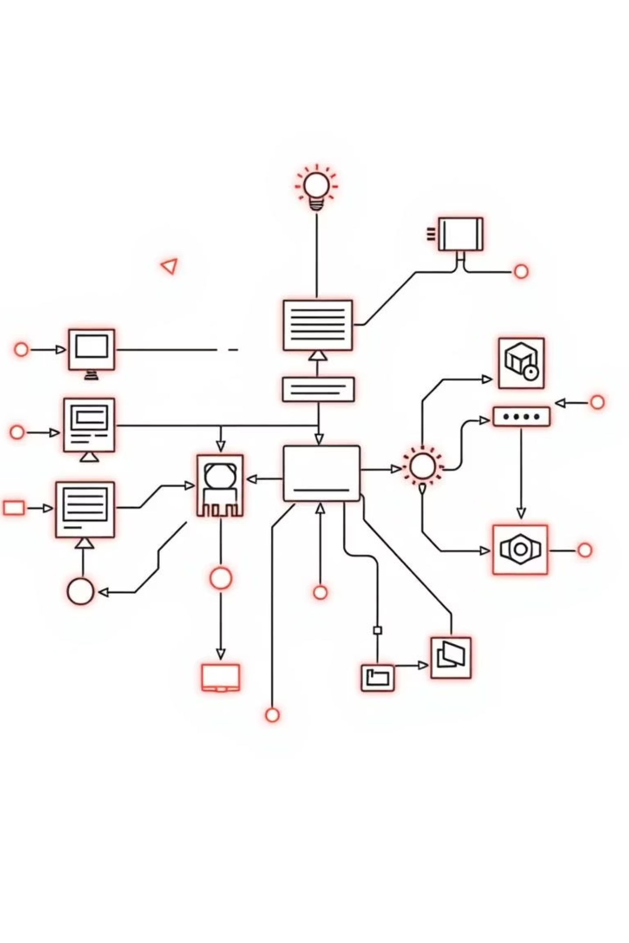
Introduction & Motivation
Why this project?
I
Urban Population Growth
Higher demand for furniture as more people move to cities and apartments
II
Shift from Houses to Apartments
Changing living patterns require different furniture solutions
III
Online Shopping Trend
Digital transformation replacing traditional furniture stores
IV
Market Opportunity
Need for an accessible online furniture sales platform
Goal: Build a basic, user-friendly furniture sales website

Slide 3
Project Objectives
Build E-commerce Website
Apply Django MVT
Practice Full-Stack
Create a furniture e-commerce platform with essential shopping features
Apply Django's Model-View-Template architecture for structured development
Gain hands-on experience in full-stack web development
Learn Best Practices
Implement industry-standard web development practices and patterns

Slide 4
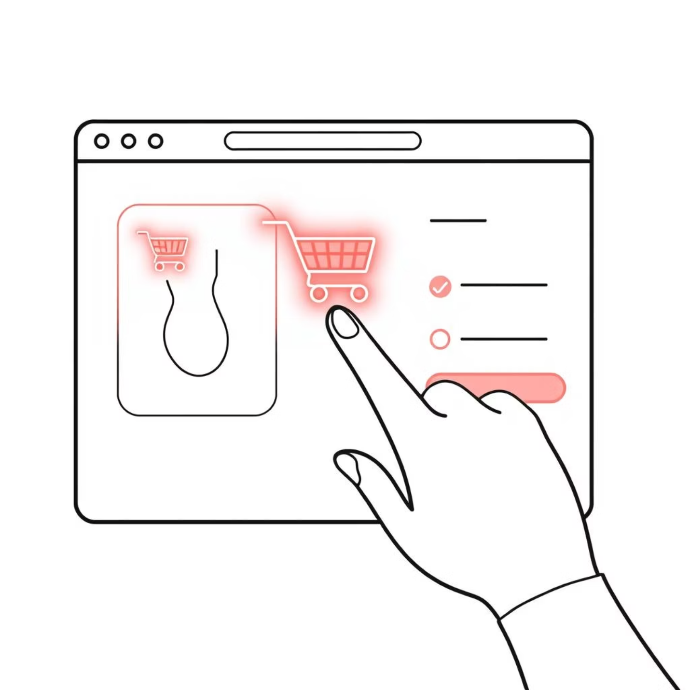
Technologies Used
Tech Stack
Frontend: HTML, CSS, JavaScript, Bootstrap 5
Backend: Django (Python)
Database: SQLite / relational database
Architecture: MVT (Model – View – Template)
Development Environment
Python web framework for rapid development
Responsive design for modern user experience
Database-driven content management

Slide 5

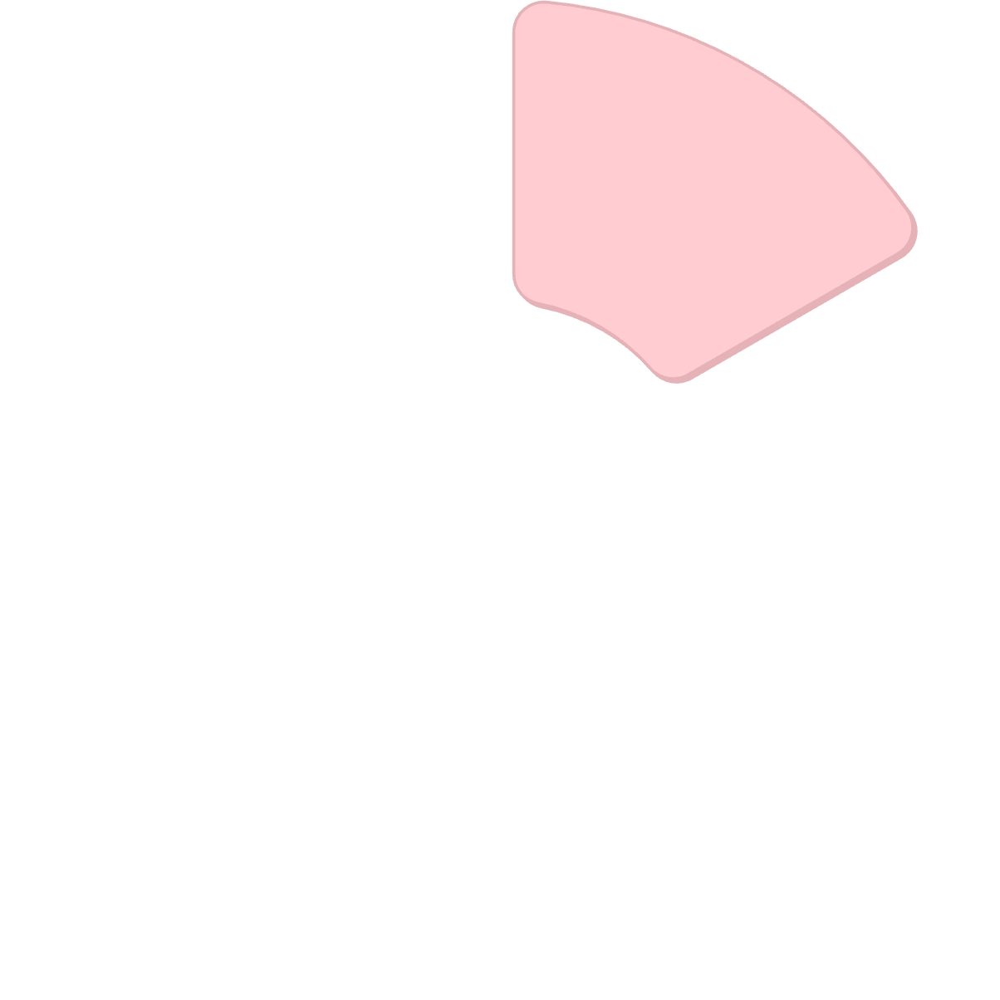
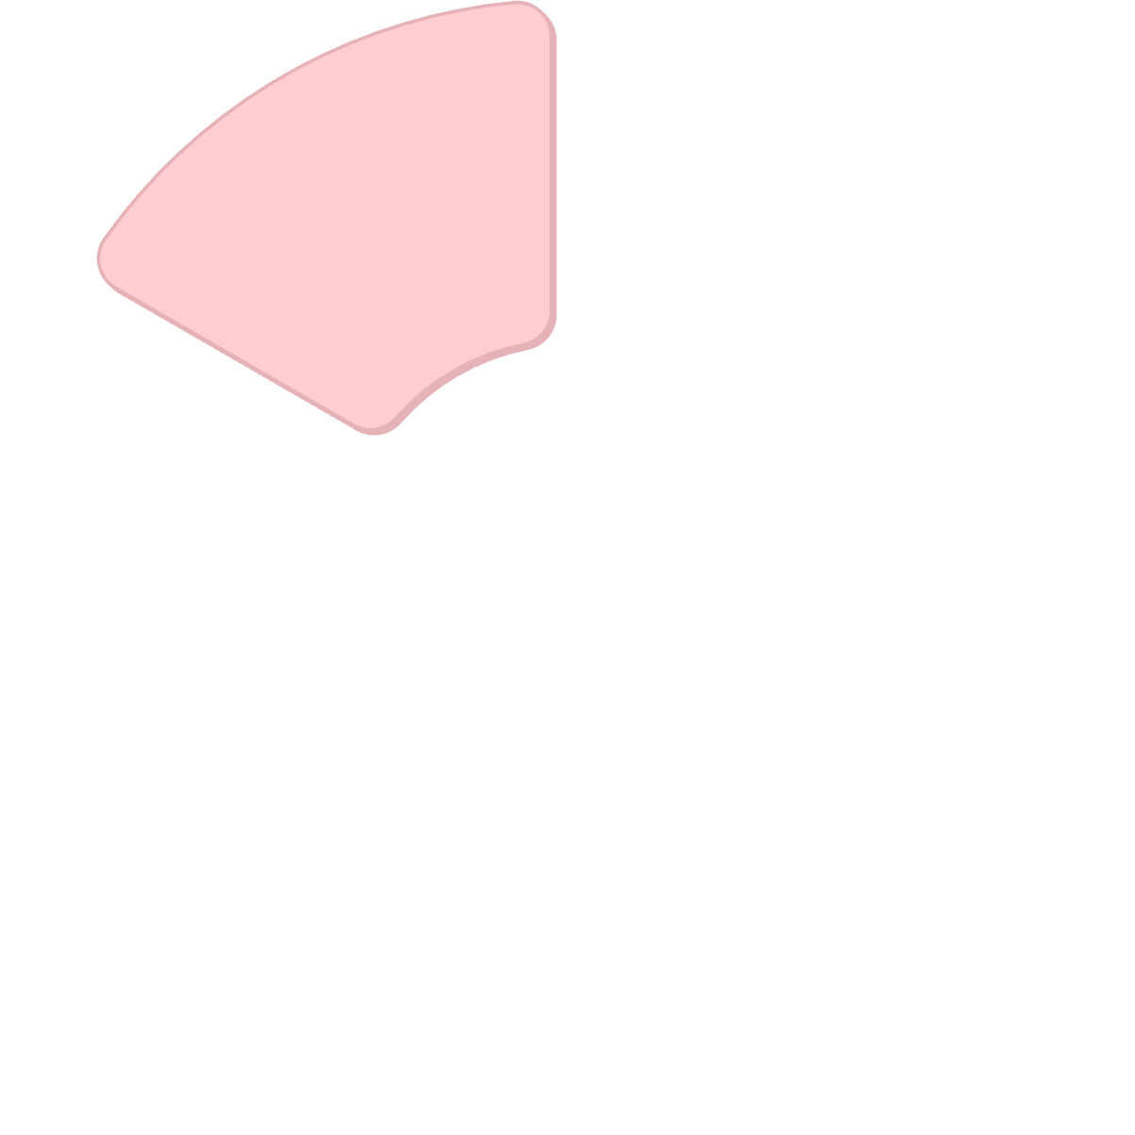

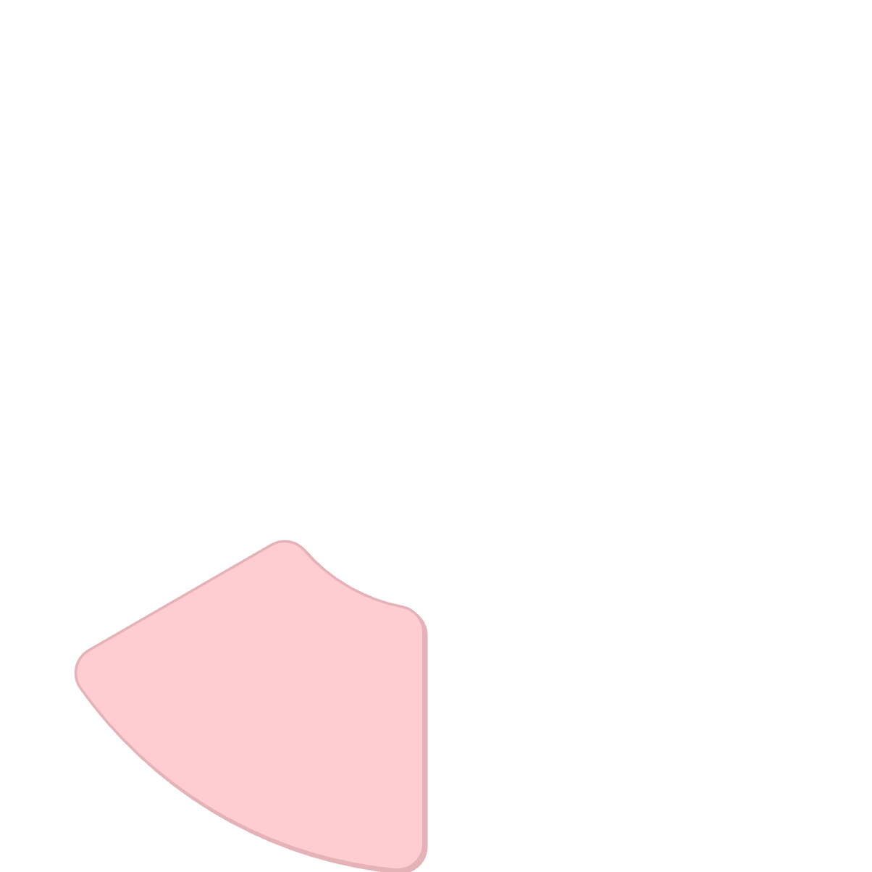

System Overview
System Diagram
The furniture e-commerce system consists of user and admin interfaces connected to core management modules.
User Interface
Admin Interface
Customer-facing website for browsing and purchasing furniture
Management dashboard for inventory and order administration
Product Management
Order Management
Order processing, tracking, and fulfillment
Catalog management, categories, and inventory tracking
Cart Management
User Management
Registration, authentication, and profile management
Shopping cart functionality and session management

Slide 6






Main Features
User Registration & Login
Product Search
Shopping Cart
Secure authentication system with user profiles
Browse and search furniture with filtering capabilities
Add/update/remove products with automatic price calculation
Order Placement
Admin Management
Complete checkout process with order confirmation
Backend interface for product and order management

Slide 7
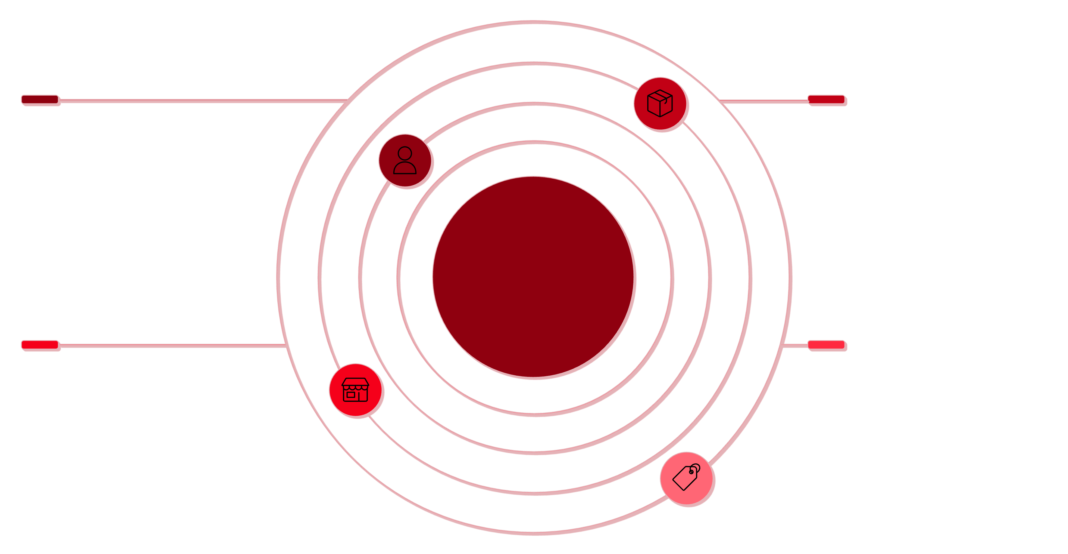
Database Design
Our database structure is designed to handle furniture products, user data, orders, and related information efficiently.
Customer
Product
customer_id PK, email, name, password
product_id PK, name, price, stock, description
E‑Commerce Database Schema
Order
OrderItem & ShippingAddress
order_id PK, customer_id FK, total_amount, status
order_item_id PK, order_id FK, product_id FK; shipping_address_id PK

Slide 8
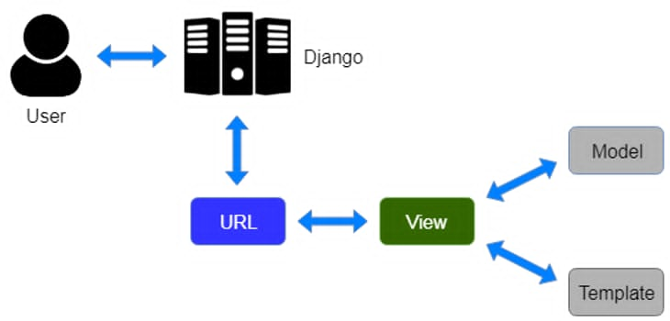



Django MVT Architecture
Model
View
Template
Database & business logic - manages data and interacts with the database
Handles request & response - acts as intermediary and manages data flow
HTML interface - renders HTML content on the user interface
Workflow: User request → URL → View → Model ↔ Database → Render Template → Response

Slide 9
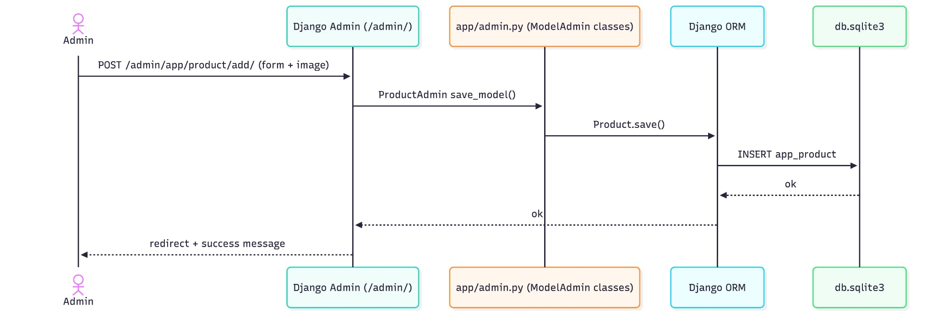
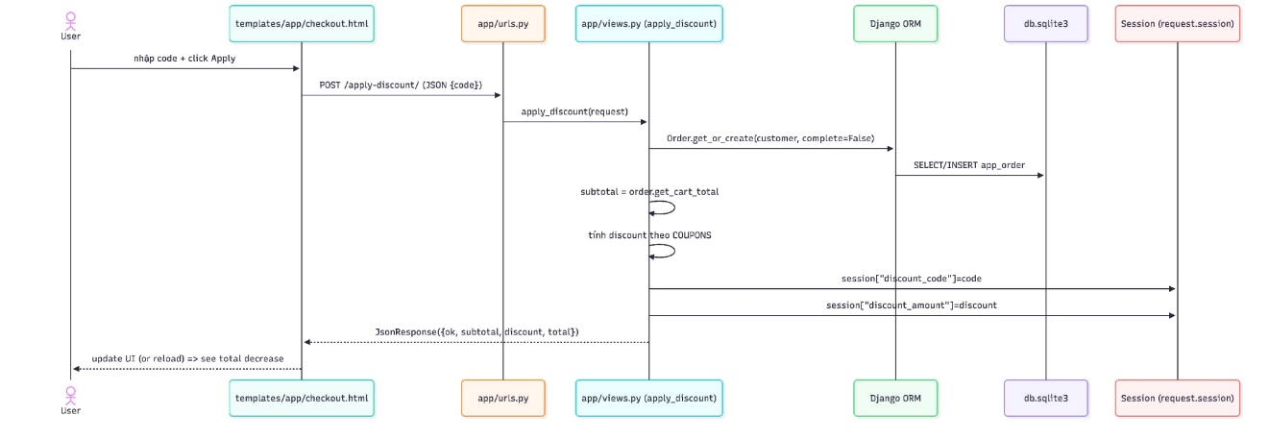
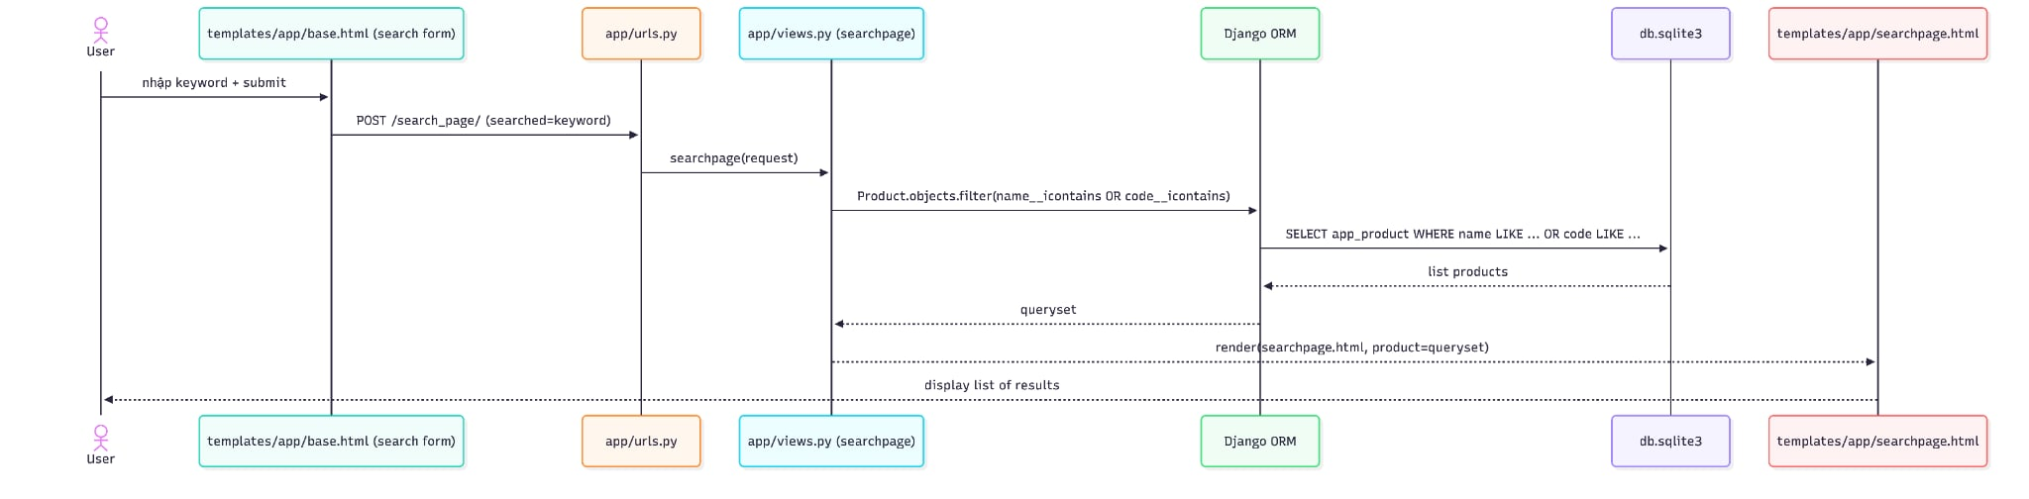
Sequence Diagram
Register → Switch to Login (NO auto-login)
Apply discount code
Search product

Slide 10
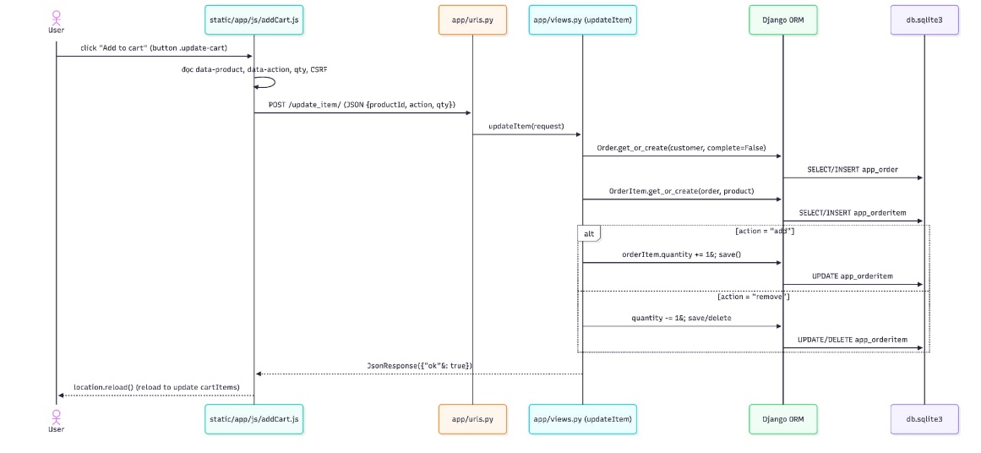
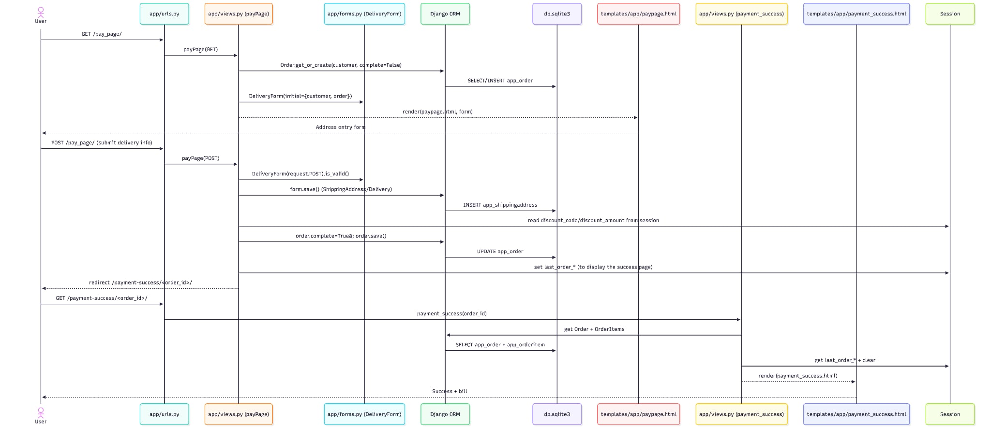
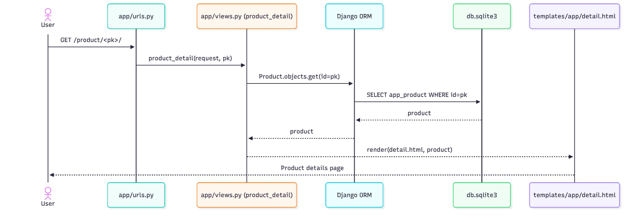
Sequence Diagram
Add to cart
Login website
View product → click View (see details)

Slide 11
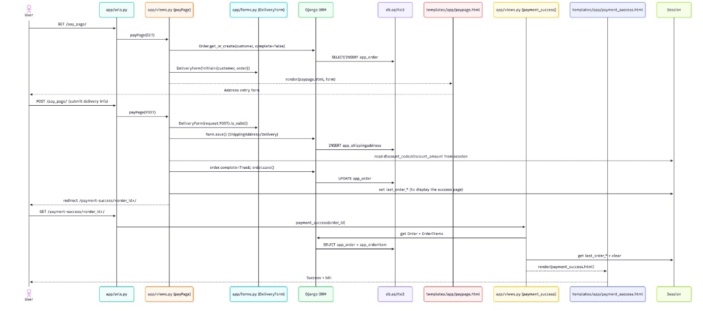
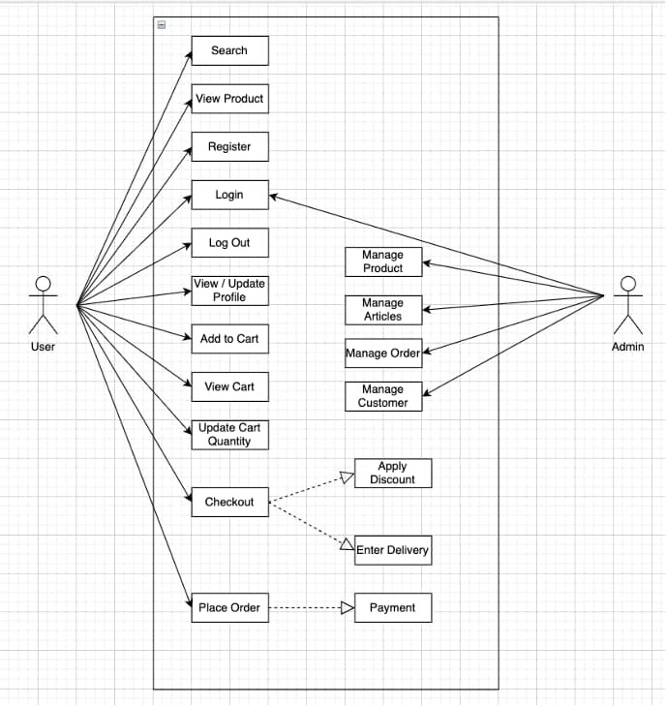
Sequence Diagram
Use case diagram
Continue Payment
Admin CRUD (add/edit/delete in/admin)

Slide 12

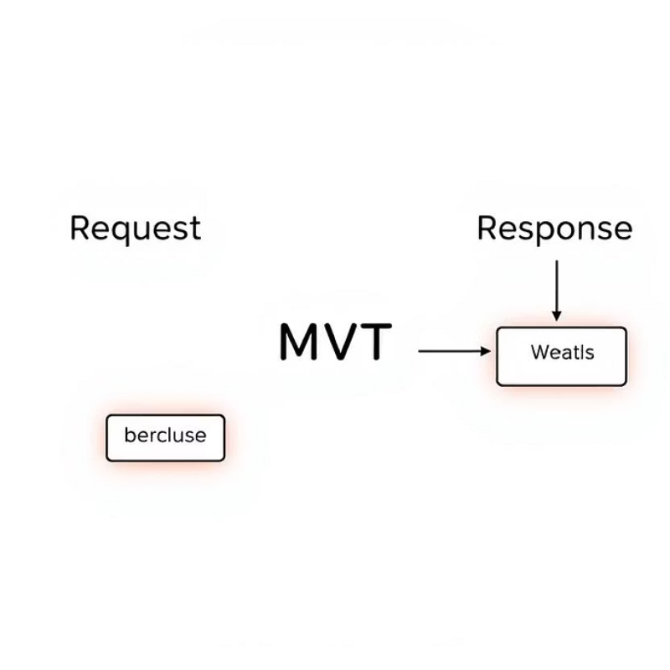

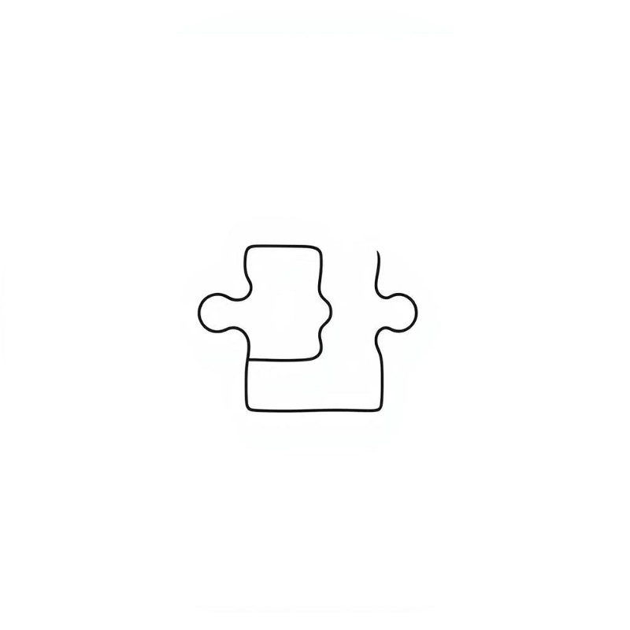
Implementation Highlights
Key interfaces and features developed during the project implementation phase.
Login Page
Homepage
Product Search
Shopping Cart
Secure user authentication interface with form validation
Featured products display with navigation and search functionality
Advanced search and filtering capabilities for furniture categories
Dynamic cart management with real-time price calculations

Slide 13
DEMO

Slide 14
Challenges & Limitations
Development Challenges
Current Limitations
Learning Curve: Understanding Django framework complexity and best practices
Search Functionality: No LLM-based intelligent search capabilities
Integration Issues: Connecting frontend and backend components seamlessly
Payment System: No integrated online payment gateway
Time Constraints: Managing project scope within academic semester deadlines
Promotions: Missing discount code and promotion features
Database Design: Creating efficient relational schema for e-commerce
UI Completeness: Some interface pages require further development

Slide 15
Conclusion & Future Work
Project Achievements
Future Improvements
Successful Implementation: Built a functional furniture e-commerce website
AI-Enhanced Search: Implement LLM-based smart search functionality
Django Proficiency: Applied MVT architecture and gained understanding of how Models, Views, and Templates interact
Payment Integration: Add secure online payment gateway support
Advanced Features: Develop discount system and promotional tools
Full-Stack Skills: Improved web development capabilities across frontend and backend
UI Enhancement: Complete remaining interface pages and improve user experience
Academic Goals: Met course requirements and learning objectives
This project successfully demonstrates the application of modern web development technologies in creating a practical e-commerce solution, providing valuable experience for future software development endeavors.

Slide 16

Thank You
Questions?
References
Django Documentation: https://docs.djangoproject.com/
Bootstrap 5 Documentation: https://getbootstrap.com/docs/5.0/
Python Official Documentation: https://docs.python.org/
Web Development Best Practices and E-commerce Design Patterns

